Slide 1

ME 200 Thermodynamics
Lecture 09 – 1st Law of Thermodynamics
Notes:
Question 5 – specific volume of R12 -

Slide 2
Conservation Principles of Thermal/Fluid Science
Mass (Thermo, Fluid Mechanics)
Momentum (Fluid Mechanics)
Energy (Thermo, Heat Transfer, Compressible Fluid Mechanics)
Entropy (Thermo)
Thermodynamics: considers macroscopic control volume; (V): mass, energy, entropy
Fluid Mechanics: adds differential cv & momentum; (dV)+(V): mass, momentum
Heat Transfer: adds/emphasizes energy (heat); (dV)+(V): mass, momentum, energy
Gas Dynamics: (dV)+(V): mass, momentum, energy, entropy
Notes:
Dashed line is reduced volume values

Slide 3
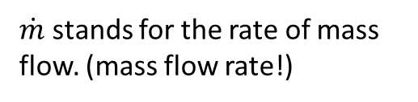
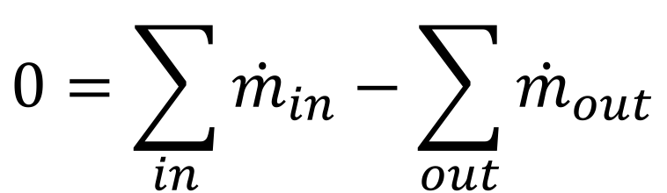
Mass: An Energy Carrier
Law of Conservation of Mass:
For any system closed to all transfers of matter and energy, the mass of the system must remain constant over time.
Corollary - Mass cannot be created or destroyed. Therefore, when mass transfers into a system, an equal amount must transfer out of the system if the system is to remain in steady-state. This is a special case for open system.
In steady-state:
$$0=\sum_{in}{{\dot{m}}_{in}}−\sum_{out}{{\dot{m}}_{out}}$$
$\dot{m}$ stands for the rate of mass flow. (mass flow rate!)

Slide 4

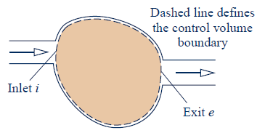

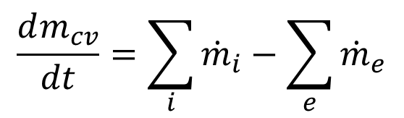

Conservation of Mass Equation
For Macroscopic Control Volume
Differential form:
$$dm_{cv}=δm_{i}−δm_{e}$$
Rate form:
$$\frac{dm_{cv}}{dt}=\sum_{i}{{\dot{m}}_{i}}−\sum_{e}{{\dot{m}}_{e}}$$
Integrated form:
$$\frac{dm_{cv}}{dt}=∫ρV_{n}dA$$
Notes:
Differential form can be integrated into the mass in and mass out
Control volume is VERY IMPORTANT

Slide 5
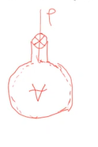
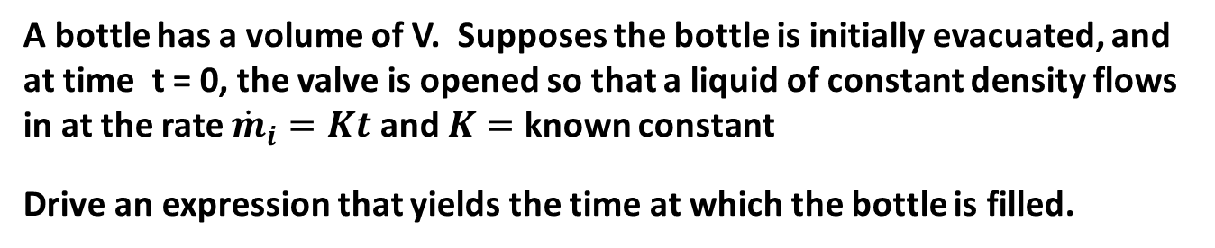
Example
A bottle has a volume of V. Supposes the bottle is initially evacuated, and at time t = 0, the valve is opened so that a liquid of constant density flows in at the rate ${\dot{m}}_{i}=Kt$ and $K=$ known constant
Drive an expression that yields the time at which the bottle is filled.

Slide 6
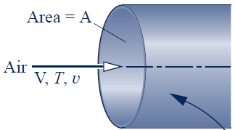
Mass Flux
Mass flow rate =
Mass flux =
Volume flow rate =
Notes:
Dot product guarantee the cross section

Slide 7
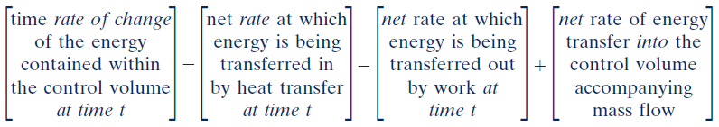
Conservation of Energy Equation
For Macroscopic Control Volume
Notes:
Q in, work out, net rate of change of energy

Slide 8
Checking Sign Convention for the 1st Law
If work, W, is performed BY the system, then its energy will…
Increase & W > 0
Decrease & W > 0
Increase & W < 0
Decrease & W < 0
Notes:
1 minute

Slide 9
Checking Sign Convention for the 1st Law
If heat, Q, is transferred TO the system, the internal energy of the system will…
Increase & Q > 0
Decrease & Q > 0
Increase & Q < 0
Decrease & Q < 0
Notes:
30 seconds

Slide 10
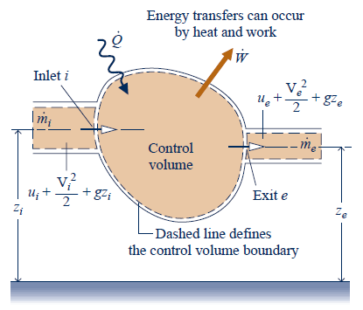
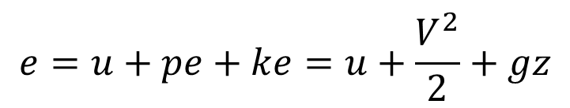
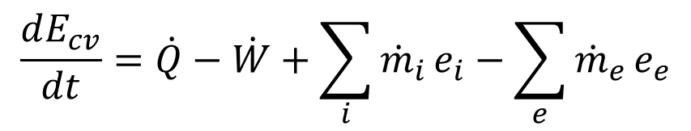


Conservation of Energy Equation
For Macroscopic Control Volume
Rate form:
$$E=U+PE+KE$$
$$e=u+pe+ke=u+\frac{V^{2}}{2}+gz$$
$$\frac{dE_{cv}}{dt}=\dot{Q}−\dot{W}+\sum_{i}{{\dot{m}}_{i}}e_{i}−\sum_{e}{{\dot{m}}_{e}}e_{e}$$
$$\dot{W}={\dot{W}}_{cv}+{\dot{m}}_{e}\left(p_{e}v_{e}\right)−{\dot{m}}_{i}\left(p_{i}v_{i}\right)$$
Notes:
Q in, work out, net rate of change of energy
Peve flow work to the system, pivi flow work done ON the system

Slide 11

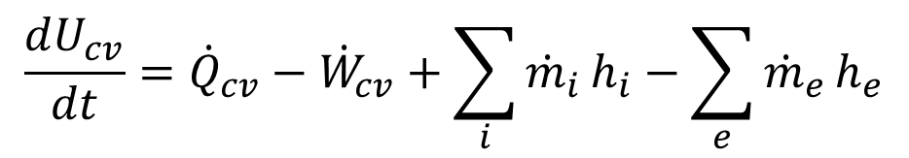
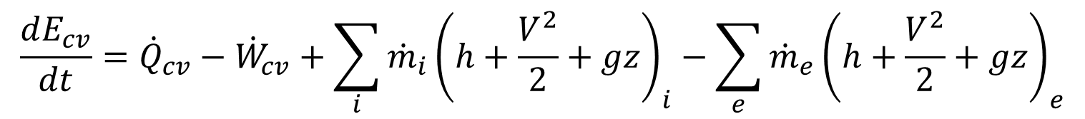
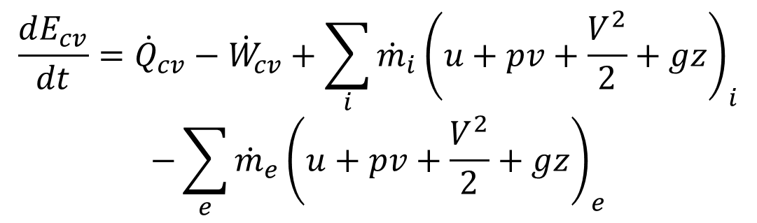
Conservation of Energy Equation
For Macroscopic Control Volume
Rate form:
$$\frac{dE_{cv}}{dt}={\dot{Q}}_{cv}−{\dot{W}}_{cv}+\sum_{i}{{\dot{m}}_{i}}{\left(u+pv+\frac{V^{2}}{2}+gz\right)}_{i}$$
$$−\sum_{e}{{\dot{m}}_{e}}{\left(u+pv+\frac{V^{2}}{2}+gz\right)}_{e}$$
$$h≡u+pv$$
$$\frac{dE_{cv}}{dt}={\dot{Q}}_{cv}−{\dot{W}}_{cv}+\sum_{i}{{\dot{m}}_{i}}{\left(h+\frac{V^{2}}{2}+gz\right)}_{i}−\sum_{e}{{\dot{m}}_{e}}{\left(h+\frac{V^{2}}{2}+gz\right)}_{e}$$
Negligible KE and PE:
$$\frac{dU_{cv}}{dt}={\dot{Q}}_{cv}−{\dot{W}}_{cv}+\sum_{i}{{\dot{m}}_{i}}h_{i}−\sum_{e}{{\dot{m}}_{e}}h_{e}$$

Slide 12
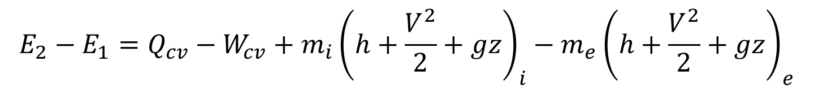
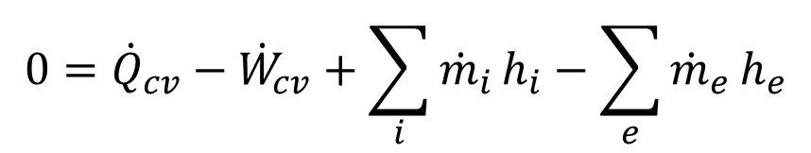



Conservation of Energy Equation
For Macroscopic Control Volume
Integrated form:
$$E_{2}−E_{1}=Q_{cv}−W_{cv}+m_{i}{\left(h+\frac{V^{2}}{2}+gz\right)}_{i}−m_{e}{\left(h+\frac{V^{2}}{2}+gz\right)}_{e}$$
Integrated form (negligible KE and PE):
$$U_{2}−U_{1}=Q_{cv}−W_{cv}+m_{i}h_{i}−m_{e}h_{e}$$
Closed system (fixed mass): ${\dot{m}}_{i,e}=0$
Open system-Steady State: $d{(E)}_{cv}/dt$ = 0
$$U_{2}−U_{1}=∆U=Q_{cv}−W_{cv}$$
$$0={\dot{Q}}_{cv}−{\dot{W}}_{cv}+\sum_{i}{{\dot{m}}_{i}}h_{i}−\sum_{e}{{\dot{m}}_{e}}h_{e}$$

Slide 13
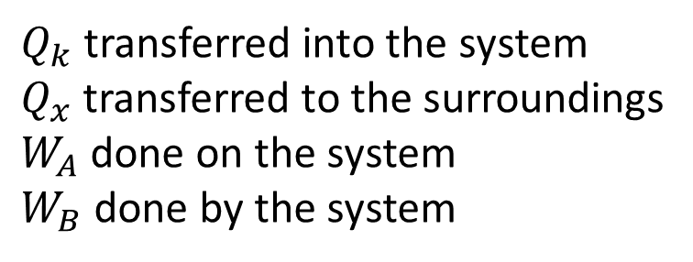
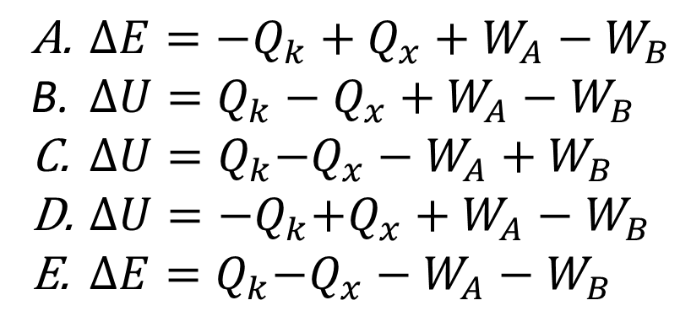
Using the 1st Law:
Neglect KE & PE
$Q_{k}$ transferred into the system
$Q_{x}$ transferred to the surroundings
$W_{A}$ done on the system
$W_{B}$ done by the system
All variables are magnitudes.
${∆E=−Q}_{k}+Q_{x}+W_{A}−W_{B}$
${∆U=Q}_{k}−Q_{x}+W_{A}−W_{B}$
${ ∆U=Q}_{k}−Q_{x}−W_{A}+W_{B}$
${ ∆U=−Q}_{k}+Q_{x}+W_{A}−W_{B}$
${ ∆E=Q}_{k}−Q_{x}−W_{A}−W_{B}$
Notes:
1 minute

Slide 14




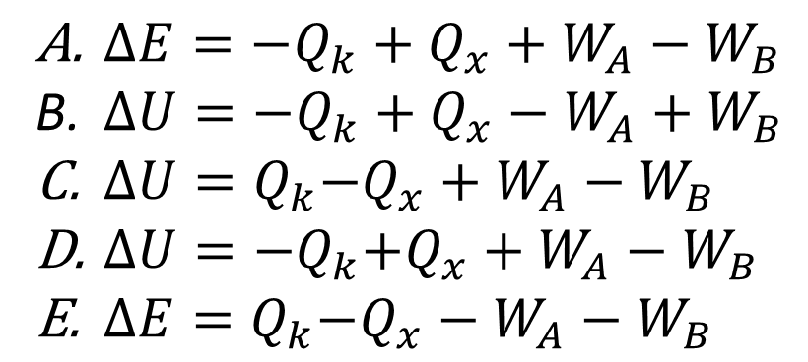
Using the 1st Law:
Neglect KE & PE
$$Q_{k}$$
$$W_{B}$$
$$Q_{x}$$
All variables are magnitudes.
$$W_{A}$$
${∆E=−Q}_{k}+Q_{x}+W_{A}−W_{B}$
${∆U=−Q}_{k}+Q_{x}−W_{A}+W_{B}$
${ ∆U=Q}_{k}−Q_{x}+W_{A}−W_{B}$
${ ∆U=−Q}_{k}+Q_{x}+W_{A}−W_{B}$
${ ∆E=Q}_{k}−Q_{x}−W_{A}−W_{B}$
Notes:
30 seconds

Slide 15

Conservation of Energy Equation
For Macroscopic Control Volume
Open system-Unsteady
Integrated form:
$$E_{2}−E_{1}=Q_{cv}−W_{cv}+m_{i}{\left(h+\frac{V^{2}}{2}+gz\right)}_{i}−m_{e}{\left(h+\frac{V^{2}}{2}+gz\right)}_{e}$$
Integrated form (negligible KE and PE):
$$U_{2}−U_{1}=Q_{cv}−W_{cv}+m_{i}h_{i}−m_{e}h_{e}$$
Closed system (fixed mass): ${\dot{m}}_{i,e}=0$
Open system-Steady State: $d{()}_{cv}/dt$ = 0
$$U_{2}−U_{1}=∆U=Q_{cv}−W_{cv}$$
$$0={\dot{Q}}_{cv}−{\dot{W}}_{cv}+\sum_{i}{{\dot{m}}_{i}}h_{i}−\sum_{e}{{\dot{m}}_{e}}h_{e}$$

Slide 16
Conservation of Energy Equation
For Macroscopic Control Volume
Rate form:
$$\frac{dE_{cv}}{dt}={\dot{Q}}_{cv}−{\dot{W}}_{cv}+\sum_{i}{{\dot{m}}_{i}}{\left(u+pv+\frac{V^{2}}{2}+gz\right)}_{i}$$
$$−\sum_{e}{{\dot{m}}_{e}}{\left(u+pv+\frac{V^{2}}{2}+gz\right)}_{e}$$
$$h≡u+pv$$
$$\frac{dE_{cv}}{dt}={\dot{Q}}_{cv}−{\dot{W}}_{cv}+\sum_{i}{{\dot{m}}_{i}}{\left(h+\frac{V^{2}}{2}+gz\right)}_{i}−\sum_{e}{{\dot{m}}_{e}}{\left(h+\frac{V^{2}}{2}+gz\right)}_{e}$$
Open system-Unsteady
Negligible KE and PE:
$$\frac{dU_{cv}}{dt}={\dot{Q}}_{cv}−{\dot{W}}_{cv}+\sum_{i}{{\dot{m}}_{i}}h_{i}−\sum_{e}{{\dot{m}}_{e}}h_{e}$$

Slide 17





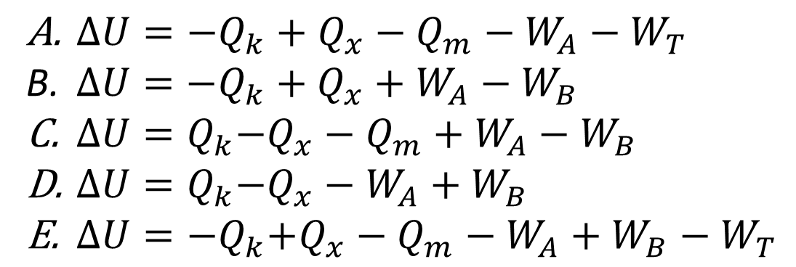

Using the 1st Law:
All variables are magnitudes.
$$Q_{k}$$
Neglect KE & PE
$$W_{T}$$
$$Q_{x}$$
$$W_{B}$$
$$Q_{m}$$
$$W_{A}$$
Choose the energy balance for the green system.
${∆U=−Q}_{k}+Q_{x}−Q_{m}−W_{A}−W_{T}$
${∆U=−Q}_{k}+Q_{x}+W_{A}−W_{B}$
${ ∆U=Q}_{k}−Q_{x}−Q_{m}+W_{A}−W_{B}$
${ ∆U=Q}_{k}−Q_{x}−W_{A}+W_{B}$
${ ∆U=−Q}_{k}+Q_{x}−Q_{m}−W_{A}+W_{B}−W_{T}$
Notes:
1 minute
B

Slide 18
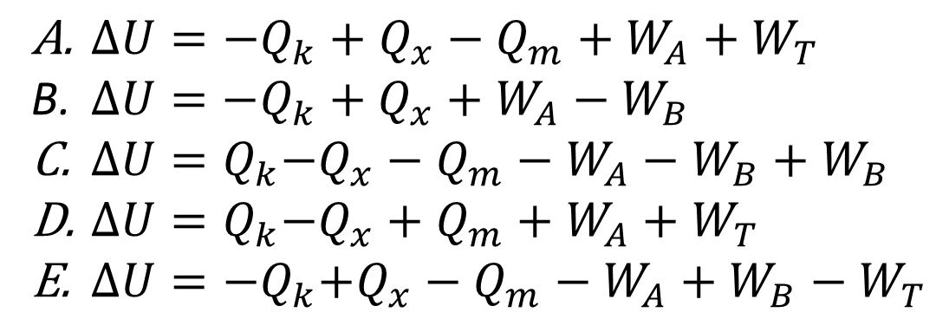
Using the 1st Law:
All variables are magnitudes.
$$Q_{k}$$
Neglect KE & PE
$$W_{T}$$
$$Q_{x}$$
$$W_{B}$$
$$Q_{m}$$
$$W_{A}$$
Choose the energy balance for the combined system.
${∆U=−Q}_{k}+Q_{x}−Q_{m}+W_{A}+W_{T}$
${∆U=−Q}_{k}+Q_{x}+W_{A}−W_{B}$
${ ∆U=Q}_{k}−Q_{x}−Q_{m}−W_{A}−W_{B}+W_{B}$
${ ∆U=Q}_{k}−Q_{x}+Q_{m}+W_{A}+W_{T}$
${ ∆U=−Q}_{k}+Q_{x}−Q_{m}−W_{A}+W_{B}−W_{T}$
Notes:
1 minute
A

Slide 19
Example
A gas is contained in a vertical piston-cylinder assembly by a piston with a face area of 0.02 m² and a mass of 40 kg. The atmosphere exerts a pressure of 1 bar on top of the piston. A paddle wheel does 3 kJ of work on the gas during a process in which the elevation of the piston increases by 0.1 m.
Which is more?
The p-V work done ON the surrounding atmosphere.
The p-V work done BY the gas.
Neither, they are equal.
Notes:
1 minute

Slide 20



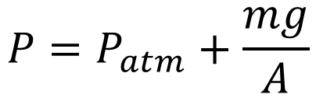
Compressibility Factor
piston
0.1 m
piston
W_{paddle}
$$P_{atm}$$
$$P=P_{atm}+\frac{mg}{A}$$
piston
$$\frac{mg}{A}$$
$$P$$

Slide 21








Compressibility Factor
piston
piston
$$W= P_{atm}∆V$$
$$W= P_{ }∆V$$
$$=\left(P_{atm}+\frac{mg}{A}\right)∆V$$
$$=(100 \left[kPa\right]) A h$$
$$=(100 [kPa])(0.02∙0.1{ [m}^{3}])$$
$$=0.24 [kJ]$$
$$=0.2 [kJ]$$
$$\frac{mg}{A}∆V=\frac{mg}{A}hA=mgh=0.04 [kJ]$$
Notes:
Potential energy change

